Slide 1
Bakery App Usability Study
August 2023
Updated September 2023
Team UXR/uxd: Elizabeth Rock

Slide 2
Table of Contents
Review
Section 1 Study Details
Section 2 Themes
Section 3 Insights & Recommendations

Slide 3
Review
After usability study was conducted, Figma was utilized to update the prototypes to fit the new user recommendations.

Slide 4
Study Details

Slide 5
Project Background
We are creating a new mobile app to help people order items for pick-up or delivery from a local bakery. Our purpose is to find out if the user experience, ordering items from the bakery app, is easy or difficult for users to accomplish.

Slide 6
Study Details
Research Questions
Participants
Methodology
How long does it take a user to get from the main screen to the confirmation page in the app?
What can research determine from the user flow or navigation in the app that each user took to get to the confirmation page?
How can the functionality of buttons and labels be changed in order to be more effective for the user.
5 participants
3 males, 2 females. One male had a physical disability. Ages were between 25-65.
15 of minutes
United States, remote
Moderated usability study
Users were instructed to perform their tasks using low-fidelity prototypes.

Slide 7

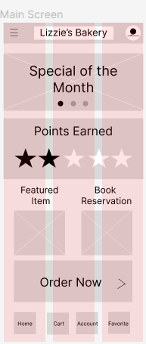
Prototype / Design Tested
https://www.figma.com/file/jQZ6nLCUJcSMTrNXOJpwWq/Untitled?type=design&node-id=38%3A2&mode=design&t=y53nLBiWjKTItgKU-1

Slide 8
Themes

Slide 9

Most users want to order delivery from the bakery to make shopping easier and more convenient.
3 out of 5 users had a hard time navigating the bakery app.
Not all users had difficulty with the navigation.
Navigation issue from main menu see at the right (no menu button).
“I was very confused most of the time with the navigatoin, I think it needs a lot of work.”(Participant 5)
a

Slide 10
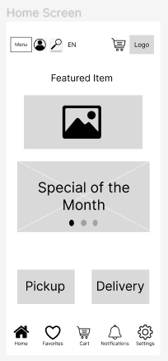
After Revision

Slide 11
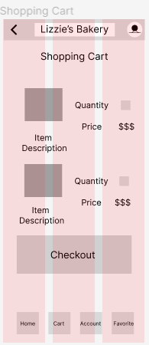
Most users thought the process from start to finish took way to long.
4 out of 5 users felt the app wasn’t beneficial as it took to long to get from the menu to confirmation.
Most users had difficulty with navigation that slowed down the process.
No menu buttons when automatically navigated to cart, user has only back button to use.
“It’s frustrating having to keep using the back button as soon as you add something to the cart.” (Participant 1)

Slide 12
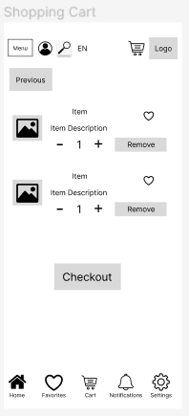
After Revision

Slide 13
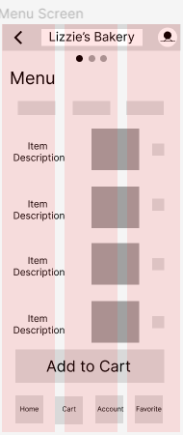
Most users felt the labels for navigation didn’t help them get through the app quickly.
3 out of 5 users felt the labels in the app for functionality were too hard to use.
Some users had difficulty figuring out where to go once using the app.
Labels aren’t clearly defined for user.
“I’m annoyed that the labels are unclear, it makes it harder to find what I want.” (Participant 3)

Slide 14
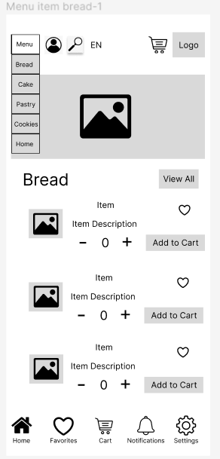
After Revision

Slide 15
Insights & Recommendations

Slide 16
Research insights
Unable to go through the process quickly
Unable to utilize buttons as intended
Unable to navigate the app
Generally users want to be able to navigate the app without too much difficulty.
Generally users want to be able to get through the process of ordering an item quickly. Especially if they are requesting delivery.
Generally users want to be able to understand label choices so they can navigate the app as desired.

Slide 17
Recommendations
Make sure the user can navigate the app without having to much difficulty.
Make sure the process of finding, placing in shopping cart, and checkout are streamlined and uncomplicated for all users.
Make sure all buttons are present and labeled correctly for every user.

Slide 18
Thank you!

